Slide 1
Restrictive Clauses In Employment Agreements In India
Second Edition – July 2017
First Edition – February 2012
Anil Chawla Law Associates LLP
www.indialegalhelp.com
Anil Chawla Law Associates LLP is registered with limited liability and bears LLPIN AAA‑8450.
This Presentation is an academic exercise. It does not offer any advice or suggestion to any individual or firm or company. While all efforts have been made to ensure accuracy and correctness of information provided, no warranties / assurances are provided or implied. Readers are advised to consult a Legal Professional / Company Secretary / Chartered Accountant before taking any business decisions. Anil Chawla Law Associates LLP does not accept any liability, either direct or indirect, with regard to any damages / consequences / results arising due to use of the information contained in this Presentation.
Copyright – Anil Chawla Law Associates LLP, 2017
This Presentation gives only an indication of the various types of restrictive clauses and their validity in terms of Indian law. It is not intended to be either complete or exhaustive narration of the subject. For a more detailed discussion on the subject, please read Guide to Restrictive Clauses in Employment Agreements in India

Slide 2
Preface
Every company needs some form of employment agreement.
Employers need to include restrictive clauses in employment agreements to protect their interests.
Restrictive clauses should be able to withstand scrutiny by courts.
One-size-fits-all approach is not suitable for employment contracts.
Time and attention need to be devoted for drafting restrictive clauses.

Slide 3
Overview
Types of Restrictive Clauses
Garden Leave Clauses
Relevant Laws
Relevant Case Law
Summary of Legal Position

Slide 4
A. Types of Restrictive Clauses
A1. Non-Disclosure Clauses
A2. Non-Compete Clauses
A3. Non-Solicitation Clauses
A4. Garden Leave Clauses

Slide 5
A1. Non-Disclosure Clauses
Each business handles confidential information related to employers / clients / suppliers / associates etc.
Each business needs to ensure that such confidential information is not disclosed to others who should not have such information.
Non-disclosure Clauses have two components-
  commitment to not disclose the confidential information to any person who is not supposed to receive it, and
  commitment to not use the confidential information for any purpose other than the business’s interest.

Slide 6
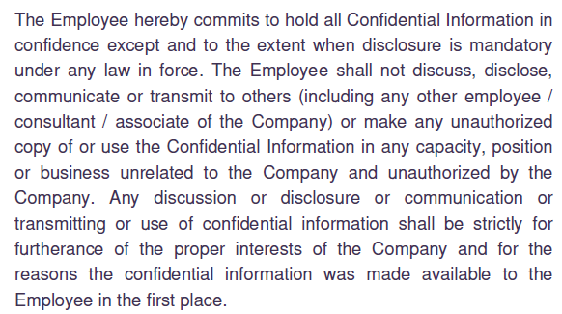
A1. Non-Disclosure Clauses (Continued)
Example 1 -

Slide 7
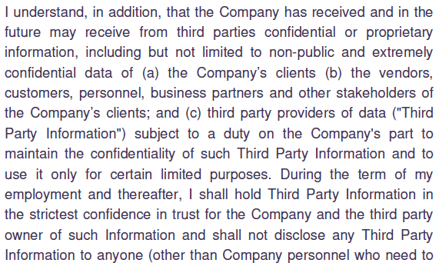
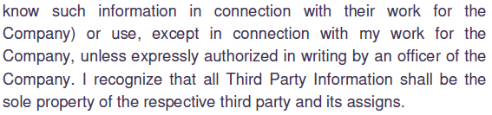
A1. Non-Disclosure Clauses (Continued)
Example 2 -

Slide 8
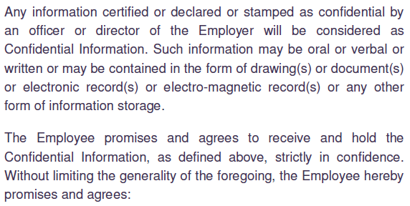

A1. Non-Disclosure Clauses (Continued)
Example 3 -

Slide 9
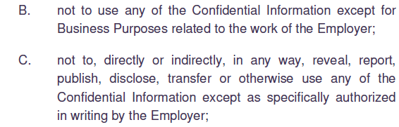
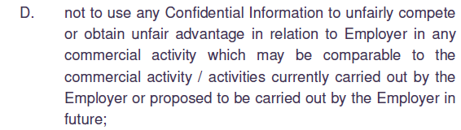
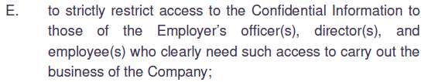
A1. Non-Disclosure Clauses (Continued)

Slide 10
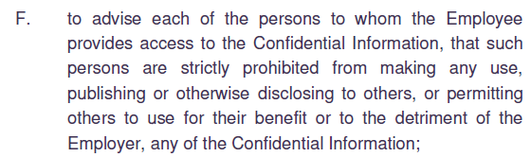


A1. Non-Disclosure Clauses (Continued)

Slide 11
A2. Non-Compete Clauses
An employer does not want its employees to do anything that will help competitors.
Possibility of employee advising competitors or becoming a competitor in future is a strong one and is often a risk.
Non-compete clauses try to protect against such a risk.

Slide 12
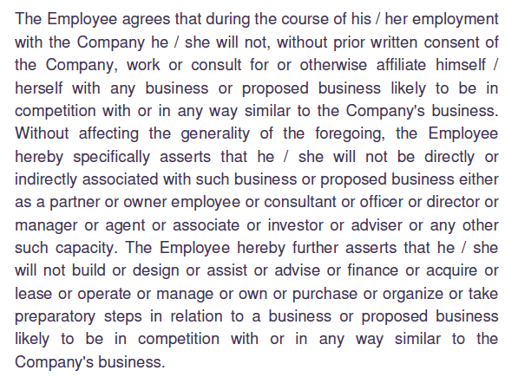
A2. Non-Compete Clauses (Continued)
Example 1 -

Slide 13
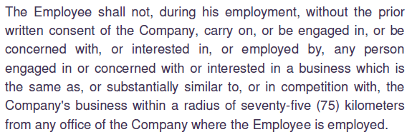
A2. Non-Compete Clauses (Continued)
Example 2 -

Slide 14
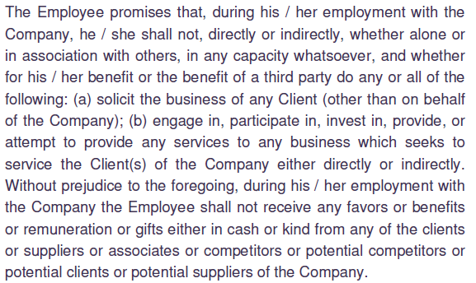
A2. Non-Compete Clauses (Continued)
Example 3 -

Slide 15
A3. Non-Solicitation Clauses
Such clauses usually provide two types of restrictions:
First - prevent an employee (either during service or after termination) from attempting to solicit or entice other employees of the employer to move away from their current jobs.
Second – prevent an employee (either during service or after termination) from contacting or dealing with clients or customers of the employer.

Slide 16
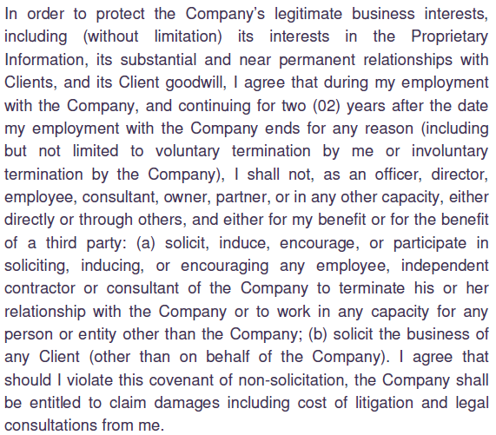
A3. Non-Solicitation Clauses (Continued)
Example 1 -

Slide 17
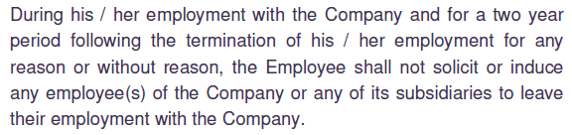
A3. Non-Solicitation Clauses (Continued)
Example 2 -

Slide 18
A4. Garden Leave Clauses
Authorizes the employer to retain an employee on its rolls without giving him / her any work, while preventing from taking up any other employment.
During Garden Leave, the employee may be prevented from entering employer’s premises and also accessing employer’s computer network.
Similar to term ‘Benching’ used in Information Technology sector, but can be much more restrictive.
Forced Garden Leave immediately after an employee resigns can prevent him / her from stealing vital information from employer.
By not relieving him / her and keeping in employment without work, employer aims to ensure that he / she is not able to join a competitor immediately. Assumed that three / six months of delay will render all information in his / her head outdated and hence useless.

Slide 19
B. Garden Leave Clauses
B1. Concept
B2. Key points for drafting
B3. Examples of Garden Leave Clause

Slide 20
B1. Garden Leave Clauses - Concept
New category of clauses in India.
The term “Garden Leave” or “Gardening Leave” originated in British Civil Service, often used as euphemism for “suspended”.
Authorizes the employer to retain an employee on its rolls without giving him / her any work and while simultaneously preventing the employee from taking up any other employment.
Guards against apprehension that the employee may use his / her presence at the premises to gather confidential information or to entice other employees away from employment.
Employers often resort to sending an employee on garden leave as soon as he / she submits resignation.

Slide 21
B2. Key points for drafting
Garden Leave must operate while the employee is in employment and NOT after cessation of employment.
Compensation given to employee during Garden Leave should be reasonable. Typically, fixed portion of salary is paid while discretionary or performance-based portion of remuneration is not paid.
Garden Leave should not be excessively long.
Garden Leave Clause should not be “unconscionable”.
Should be a part of the employment agreement which the employee has executed without any duress.

Slide 22
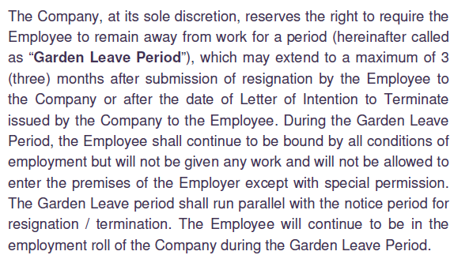
B3. Garden Leave Clause - Examples
Example 1 -

Slide 23

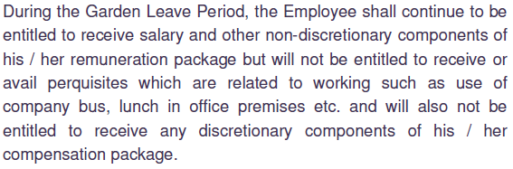
B3. Garden Leave Clause – Examples (Continued)
Example 1 (Continued) -

Slide 24
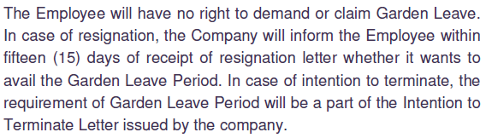

B3. Garden Leave Clause – Examples (Continued)
Example 1 (Continued) -

Slide 25
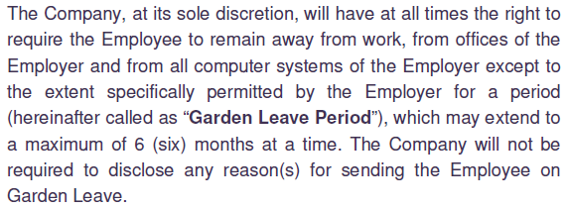
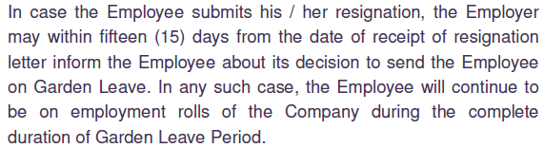
B3. Garden Leave Clause – Examples (Continued)
Example 2 -

Slide 26
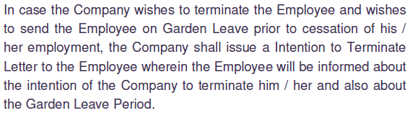
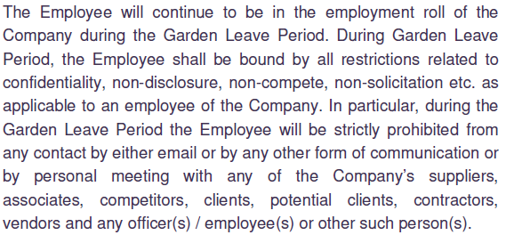
B3. Garden Leave Clause – Examples (Continued)
Example 2 (Continued) -

Slide 27
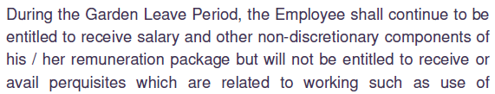

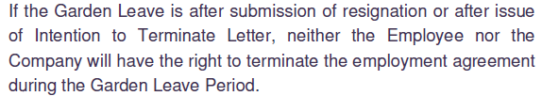
B3. Garden Leave Clause – Examples (Continued)
Example 2 (Continued) -

Slide 28
C. Relevant Laws
C1. Indian Contract Act, 1872
C2. Constitution of India
C3. The Competition Act, 2002

Slide 29
C1. Indian Contract Act, 1872
Indian Contract Act provides conditions that make a contract void.
A void contract is one which cannot be enforced under laws of India.
Void contracts can be classified into four categories –
  Contracts with unlawful objects or consideration (Section 23 & 24)
  Contracts without consideration (Section 25)
  Contracts in restraint of marriage (Section 26)
  Contracts in restraint of trade (Section 27).

Slide 30
C1. Indian Contract Act, 1872 (Continued)
Restraint of marriage
Any employment contract that restrict the employee from marrying are void.
Example : A film producer may want leading heroine of his film to not marry till the film is released. Enforceability of such contracts is doubtful.
Restraint of Trade
Restrictions imposed on an employee during the period of employment are valid, while restrictions imposed after termination of employment are void.

Slide 31
C2. Constitution of India
Article 19 (1)(g) guarantees all citizens the right to practice any profession or occupation or trade or business of their choice.
However, this right is not unqualified. Can be restricted and regulated by the authority of law.
Fundamental rights are available only against the State i.e. government or government undertakings.
No scope when the relationship is between a private employer and an individual employee.

Slide 32
C3. The Competition Act, 2002
Common sense dictates that restrictive clauses in employment agreements restrict competition .
However, Competition Commission of India opined that restrictive clauses in employment raise no competition issues. (Ref. Larry Lee Mccallister Vs. Pangea3 Legal Database Systems (P.) Ltd.; Decided on 6th November 2013, MANU/CO/0083/2013).
Till the Honourable Supreme Court rules otherwise, we must consider that Competition Act 2002 has no relevance to restrictive clauses in employment agreements.

Slide 33
D. Relevant Case Law
D1. Post-termination restraints are void
D2. Restraint of Non-solicitation after End of Employment Allowed
D3. Post-contractual Restraints Disallowed
D4. Unconscionable Terms
D5. Payment on resignation - Unconscionable
D6. Contractual Commitments to be adhered

Slide 34
D1. Post-termination Restraints are Void
Appointment letter of an employee contained some conditions under which the employee agreed that during the course of employment, he would not be permitted to engage himself in any part time job.
Also, the employee was not permitted to join any firm of competitors or run a business of his own on similar lines, for a period of two years at the place of his last posting after he leaves the company
In due course, the employee was terminated. After termination, he started carrying on business of nature similar to that of his former employer.
Superintendence Company of India (P) Limited Vs. Sh. Krishan Murgai, Supreme Court, Decided on 21 March 1980 / 9 May 1980, MANU/SC/0457/1980

Slide 35
D1. Post-termination Restraints are Void (Continued)
The company brought a suit for a permanent injunction to restrain the employee from his post-termination activities.
Honourable Supreme Court held that termination does not amount to leaving the company. The clause which was supposed to operate on the employee leaving the company will not operate if he is terminated.
The Honourable Supreme Court unequivocally stated that “a service covenant extended beyond the termination of the service is void”.

Slide 36
D2. Restraint of Non-solicitation after
End of Employment Allowed
The employee signed an Obligation Agreement under which he agreed that for two years after ending of employment –
He would not compete directly or indirectly against the company and its group companies
He would not interfere with the relationship of the company with its customers, suppliers and employees
He would not disclose the confidential information to which he was privy as employee of company to any third party
He would deliver back all properties of the company which were in his possession; and
He would not retain copies of any of the properties of the company
Desiccant Rotors International Pvt. Ltd. Vs. Bappaditya Sarkar and Anr., Delhi High Court, Decided on 14 July 2009, MANU/DE/1215/2009

Slide 37
D2. Restraint of Non-solicitation after
End of Employment Allowed (Continued)
Within three months of leaving employment the employee joined a competitor of the company.
The Honourable High Court took the view that an employee’s right of livelihood must prevail over employer’s right to restrict employee from joining competitive business.
The court opined that the employer had a right to refrain employee from approaching its suppliers and customers for soliciting business for a period of two years after cessation as an employee.
Post-employment restriction on joining a competitor was rejected but the restriction of non-solicitation for two years after cessation was protected.

Slide 38
D3. Post-contractual Restraints Disallowed
The company had entered into an agreement with a cricketer of national repute on 1st October 2000 for a period of three years expiring on 29th October 2003.
The agreement included a condition that the player could not accept any offer for endorsements, promotions, advertising or other affiliation with regard to any product or services during the period of agreement.
The cricketer informed the company that he was not interested in renewing and/or extending the terms of the said agreement beyond October 2003.
Percept D' Mark (India) Pvt. Ltd. Vs. Zaheer Khan and Anr. Supreme Court, Decided on 22 March 2006, MANU/SC/1412/2006

Slide 39
D3. Post-contractual Restraints (Continued)
In November 2003, the cricketer entered into an agreement with a third party. The company protested against this and pulled the cricketer to court.
The Honourable Court affirmed that even if a post-contractual restraint is reasonable it would still be null and void under section 27 of the Contract Act. Moreover, partial restraints are also disallowed. In other words, reasonableness or the fact that restraint is not total, cannot be used as a defence to justify any form of post-contractual restraints.

Slide 40
D4. Unconscionable Terms
The Honourable Supreme Court had to decide whether an unconscionable term in a contract of employment makes the contract void under Section 23 of the Indian Contract Act, 1872.
Honourable Supreme Court defined “unconscionable” as something that is not right or reasonable.
The Honourable Court decided that it is the duty of courts to intervene and strike down all contracts that are unconscionable.
Central Inland Water Transport Corporation Limited and Anr. Vs. Brojo Nath Ganguly and Anr, Supreme Court, Decided on 6 April 1986, MANU/SC/0439/1986

Slide 41
D4. Unconscionable Terms (Continued)
The Honourable Court decided that all contracts which contain unconscionable terms are void.
The general rule formulated by this case is that in an employment agreement any restrictive clause which the court considers to be “unconscionable” will be considered as opposed to public policy and will be void.

Slide 42
D5. Payment on resignation - Unconscionable
The employment contract between the Employee (Petitioner) and the Employer (Bank) provided for payment of Rs.2,00,000/- by the Petitioner to the Bank if he leaves the job before three years.
The Petitioner submitted his resignation before completing three years of service and had to pay the aforesaid amount to the Bank.
The Honourable High Court declared the said condition of employment as unconscionable and hence void.
Prashant B. Narnaware vs. Vijaya Bank, Karnataka High Court, Decided on 8 August 2012, MANU/KA/1209/2012

Slide 43
D6. Contractual Commitments to be adhered
The Petitioner (Employee), a doctor, had executed a bond with his employer to serve the employer for a minimum period of 6 years after completion of his PG course sponsored by the employer or to reimburse to employer the amount of pay and allowance for the bond period and expenditure on study, if he leaves the job before 6 years.
The Petitioner resigned from the job before serving the Employer for 6 years.
The Honourable High Court looked at amounts claimed by the Employer from the Doctor on account of leave and other facilities granted to him for post-graduate studies.
Dr. S. Gobu vs. The State of Tamil Nadu, Madras High Court, Decided on 8 July 2010, MANU/TN/0675/2010

Slide 44
D6. Contractual Commitments (Continued)
Honourable High Court held that the contractual commitments must be adhered to by the Petitioner. It is not open for the Employee to have on one hand benefit of getting admission as a service candidate along with leave and on the other hand not pay the quantified damages provided in the contract.
The Honourable High Court did not consider the contract terms as unconscionable.
The Honourable High Court refused to let the Employee have the benefit of section 27 of Contract Act.

Slide 45
E. Summary of Legal Position

Slide 46
E. Summary of Legal Position
Restrictions imposed on an employee during the employment are legally enforceable.
Restrictions on future employment / trade imposed on an employee after cessation of employment are void.
Partial restriction on trade after end of employment also lack legal enforceability.
Unconscionable term in a contract of employment is void even during the period of employment.

Slide 47
E. Summary of Legal Position (Continued)
Employee has the right to engage in any gainful activity after his employment ceases but not to take away confidential intellectual property of the employer or solicit his suppliers / clients.
Protection under Article 19 (1) (g) of Constitution of India is available only when the employer is either the government or a government undertaking.
As per Competition Commission of India, Competition Act has no relevance with restrictive clauses in employment agreements.

Slide 48

Helps you with –
Strategic Advice, International Investment Arbitration, International Commercial Arbitration, Corporate Relationships, Resolving Disputes without Litigation, Structures for Global Business Entities, Research based opinion
We take an entrepreneur’s perspective on every issue.
Seeing our clients' business grow and prosper is our passion.
www.indialegalhelp.com
info@indialegalhelp.com
We follow a transparent system for fees. Please look at our Indicative Rates (http://www.indialegalhelp.com/files/indicativerates.pdf ) before contacting us.

