Slide 1
Quick Guide to Wills for Hindus
April 2018
Anil Chawla Law Associates LLP www.indialegalhelp.com
Anil Chawla Law Associates LLP is registered with limited liability and bears LLPIN AAA‑8450.
This Presentation is an academic exercise. It does not offer any advice or suggestion to any individual or firm or company. While all efforts have been made to ensure accuracy and correctness of information provided, no warranties / assurances are provided or implied. Readers are advised to consult a Legal Professional / Company Secretary / Chartered Accountant before taking any business decisions. Anil Chawla Law Associates LLP does not accept any liability, either direct or indirect, with regard to any damages / consequences / results arising due to use of the information contained in this Presentation.
Copyright – Anil Chawla Law Associates LLP, 2018
This Presentation gives only an overview of Wills and Advance Medical Directives. It is not intended to be either complete or exhaustive narration of the subject.

Slide 2
Preface
Traditionally Hindu law did not have a provision for Wills. It is only after 1956 that Hindus became eligible to make a Will. Even now there is a misconception that a Hindu can make a Will only in respect of one’s self-earned properties and not for one’s inherited properties. Presently, it is advisable for every Hindu to make a Will well before the anticipated time of final departure.
The primary purpose of a Will is to ensure that there is no acrimony in the family after the key person’s death. A Will, in addition, ensures smooth passing of properties from one generation to the other without any tax liability.
Example – A person had two sons and two houses. He decided to give the larger house to the elder son and the smaller house to the younger one. Both sons agreed to the distribution. Father died without a Will. Sons wanted the houses transferred to their respective names. They were asked to draw up a Settlement Agreement specifying the division of properties between them. They did as advised. When they went for conveyance of houses, they were asked to pay up stamp duty amounting to about 5% of the value of the two houses. This could have been avoided if the Father had executed a Will.
This Quick Guide is for Hindus living in India having properties in India. For a detailed exposition of the subject, please read our Guide to Wills for Hindus.

Slide 3
Overview
Who is Hindu?
What is Will?
Who can make Will?
Properties Covered by Will
Procedural Requirements
Witnesses
Drafting Will
Joint and Mutual Will
Executor / Administrator
Will as Trust Deed
Modification / Revocation
Procedure after Death
Advance Medical Directives

Slide 4
1. Who is Hindu?
Section 2 of The Hindu Succession Act, 1956 defines Hindu as follows:

Slide 5
2. What is a Will
Legal Declaration
Statement of Intention of Testator
With respect to testator’s property
Desires to be carried into effect after testator’s death
Some Relevant Terms
Intestate Succession / Testamentary Succession
Codicil
Probate / Letter of Administration

Slide 6
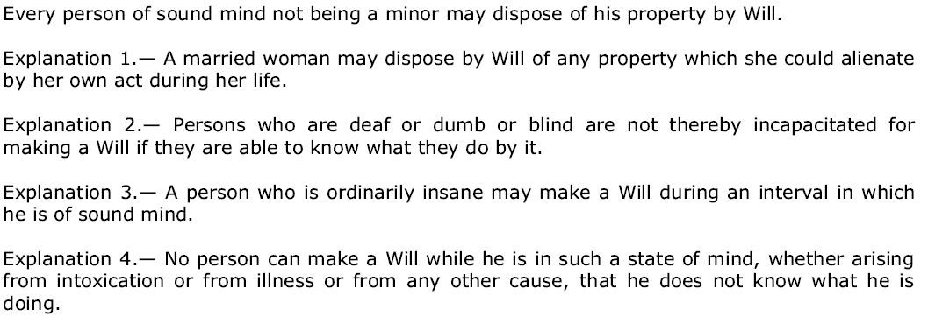
3. Who can make a Will
Not a minor (>18 years)
Of sound mind

Slide 7
3. Who can make a Will (Continued)

Slide 8
4. Properties Covered by Will
One can only give away what one has.
Ownership or other rights on the date of death relevant.
Immovable properties governed by law of land.
Movable properties governed by law of domicile.
If one has immovable properties outside India, Will as per law where properties are located.
A Will as per Indian law can be made anywhere in the world.

Slide 9
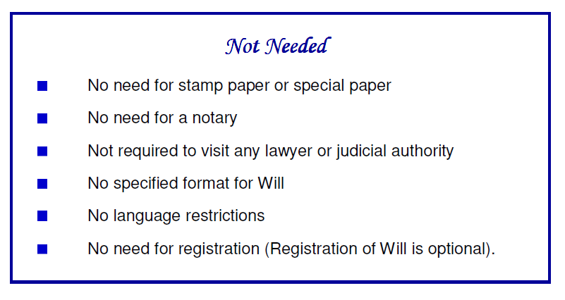
5. Procedural Requirements

Slide 10
5. Procedural Requirements (Continued)
Must be in writing.
Signed by testator in the presence of witnesses.
Signed by the witnesses in the presence of testator.
Attesting witnesses must sign in capacity of witnesses.
A personal acknowledgment by the testator of witnesses.
Advised that each page be signed by the testator as well as the witnesses.

Slide 11
5. Procedural Requirements (Continued)
Any overwriting in Will must be signed by testator as well as witnesses.
Safekeeping of the Will – Multiple copies advised kept with different persons (beneficiaries) .
Registration – Optional. Recommended when Will is not being disclosed to legatees. Registration prevents keeper of Will from committing forgery.
Fraud or coercion makes a Will null and void.
Flattery or taking care of testator does not affect the Will’s legal status.

Slide 12
6. Witnesses to Will
Beneficiary can be a witness. But strongly advise against it.
Witness must NOT be of doubtful integrity or character.
Witness should preferably be literate and be able to stand cross-examination by aggressive lawyers.
Person named as executor can be witness. But advised that it be avoided.
A corrupt witness can undo a Will after the death of testator.

Slide 13
7. Drafting of Will
No prescribed format
Language should be the one that testator is comfortable with
Must be simple and easy to understand
Avoid legalese – no legal terms; no reference to laws
Must convey intentions of the testator in clear terms
Should be specific
General preaching and philosophical thoughts to be avoided
Must not be ambiguous in any way
A person with no knowledge of law should be able to understand and interpret it.

Slide 14
7. Drafting of Will (Continued)
Date – Not a legal necessity, but highly recommended. Should appear at only one place in the document.
Description of Testator – Name, father’s name, address, approximate age should be written. Preferable to mention religion, domicile (for NRI’s), PAN / AADHAAR / Passport No.
Description of Properties – Can either be general like “all my bank accounts” or be specific. For immovable properties detailed description giving address, size etc. advised. In case testator has partial or limited rights, same be mentioned.
Description of Beneficiaries / Legatees – Identify by name as well as relationship. May also provide other details like father’s name, approximate age, address, and some identification number.

Slide 15
7. Drafting of Will (Continued)
Numbering of Paragraphs – Not a legal requirement, but advised for clarity.
Revocation of Previous Wills – Mention of all previous Wills is highly recommended. Advised that all previous Wills are revoked and the new Will is a comprehensive document.
Denial of Benefit to Natural Heirs – If Will denies benefits to natural heirs, it is advised that reasons for denial are mentioned.
Bequest for Charity or Religious Purposes – Allowed to Hindus.
Bequest to Minor Children – Allowed.
Residuary Legatee – Recommended that there be a legatee who gets what no one else gets.

Slide 16
8. Joint and Mutual Will
Law in India does not recognize husband and wife as joint owners of all properties acquired after marriage.
If either of husband / wife dies intestate, property of deceased is divided equally among the survivor and children of the couple. This can often lead to much distress and pain for survivor in old age. For example, it may lead to displacement from family home or may lead to dissipation of pension deposits intended for old age.
A Joint and Mutual Will gives all properties of the deceased to the survivor.
It may provide for distribution of properties after death of both husband and wife.

Slide 17
9. Executor / Administrator
Executor is appointed by the testator in Will.
Administrator is appointed by competent authority.
Any person (including beneficiary) can be named as executor.
Executor need not be legal professional or have knowledge of law.
Executor represents deceased and holds all powers of deceased.
Not compulsory to appoint executor.
A dishonest / rogue executor can be a big nuisance.
When no executor is named in Will, beneficiaries can apply for Letter of Administration or can get conveyance without court intervention.

Slide 18
10. Will as Trust Deed
Private Trust is created for the benefit of specific beneficiaries. Public Trust is for undefined beneficiaries or charity or religious purposes.
Private Trust can be created using Will only using movable properties. Immovable properties cannot be transferred to Trust using Will.
Private Trust typically created when beneficiaries are incapable of managing their affairs like in case of physically or mentally challenged persons; also used for children; abroad common to use private trusts for pets.

Slide 19
10. Will as Trust Deed (Continued)
Intention to create Trust should be clearly mentioned.
Purpose of the Trust should be clearly stated.
Beneficiaries should be clearly named.
Movable property being moved to Trust should be clearly defined and there should be no confusion or uncertainty around it.
Trustee(s) should be clearly named and / or the process of appointing trustee(s) should be clearly specified.
Directions for dissolution of private trust and distribution among beneficiaries should be clearly stated.

Slide 20
11. Modification / Revocation
A Will can be modified / revoked anytime during lifetime of testator.
Modification / revocation to be done same way as execution. Sound mind + Two attesting witnesses.
Modification by overwriting after execution not allowed.
Revocation by burning or tearing of Will allowed but burning or tearing must be in front of two witnesses.
Witnesses required for modification / revocation. Same witnesses as for original Will not required.
Modification / revocation of registered Will need not be registered, but advisable.

Slide 21
12. Procedure after death of testator
Probate / Letter of Administration is almost compulsory in Mumbai and Chennai, but mostly not required in rest of India.
In most parts of India, a notarized true copy (in some places a photocopy) of Will and Death Certificate of testator sufficient to get conveyance of property in favour of legatee.
Application for probate by Executor.
Application for Letter of Administration by a beneficiary if there is no executor named in the Will.
Probate / Letter of Administration granted by appropriate court.

Slide 22
13. Advance Medical Directives
Advance Medical Directives (AMD) / Living Will are directions to one’s near and dear ones to take critical decisions during:
A terminal condition – an incurable or irreversible condition which even with the administration of life-sustaining treatment will result in death in foreseeable future.
A persistently unconscious condition – an irreversible condition, in which thought and awareness of self and environment are absent.
An end-stage condition – a condition caused by injury, disease or illness which results in severe and permanent deterioration indicated by incompetency and complete physical dependency for which treatment of the irreversible condition would be medically ineffective.

Slide 23
13. Advance Medical Directives (Continued)
Essential Concepts:
AMD and Will are very different; cannot be combined. AMD relates to before death. Will relates to after death.
Active Euthanasia – some action like injecting a poison is absolutely illegal. AMD does not relate to active euthanasia.
Passive Euthanasia – not providing some life saving treatment or withholding or withdrawing life support systems. Allowed subject to safeguards.
Medical Power of Attorney – Also called guardian / caretaker / trusted agent. To take critical healthcare decisions when one is not able to take such decisions.

Slide 24
13. Advance Medical Directives (Continued)
Execution of AMD:
Only adult can execute
Must be of sound mind
Voluntarily executed without fraud or coercion
Must be in writing
Must lay down in clear terms (a) when medical treatment may be withdrawn and (b) when specific medical treatment shall not be given.

Slide 25
13. Advance Medical Directives (Continued)
Procedure for execution of AMD:
Like Will to be signed in front of two or more witnesses.
To be countersigned by Judicial Magistrate of First Class (JMFC).
Copies to be given to JMFC, family members, district court, family physician, local government (municipal corporation / panchayat).
No stamp duty required.
No particular format prescribed.
No registration / fees.

Slide 26
13. Advance Medical Directives (Continued)
Giving Effect to AMD – Four stage protection:
Guardian or caretaker named in the AMD
Doctor treating the patient
Medical Board constituted by the hospital
Medical Board constituted by the District Collector.

Slide 27
For a more detailed exposition on the subject, please read Guide to Wills for Hindus
We shall be glad to assist and advise you for preparation of a Will / AMD.
www.indialegalhelp.com
info@indialegalhelp.com
We follow a transparent system for fees. Please look at our Indicative Rates (http://www.indialegalhelp.com/files/indicativerates.pdf ) before contacting us.

