Slide 1
Interpretation of Statutes and Agreements in India
Based on presentations by PCS Shruti Manwani and Advocate Anil Chawla at
Skill Development Program
Organized by
Institute of Company Secretaries of India
Bhopal Chapter
On 12th February 2016
At ICSI Bhopal Chapter Office
Anil Chawla Law Associates LLP
www.indialegalhelp.com
This Presentation gives only an indication of the various rules and practices related to interpretation.
It is not intended to be either complete or exhaustive narration of the subject

Slide 2
Preface
Interpretation of statutes is a subject that all legal professionals study as part of their academic curriculum. However, the subject is often perceived to be highly theoretical and esoteric. This is a subject that every legal professional is supposed to know and also claims to know, while being aware in his / her heart of never studying the subject to any great depth. Given this state of affairs among legal professionals, it is not surprising that non-legal professionals have no inkling of the subject.
This Guide is primarily meant for non-legal professionals like engineers, entrepreneurs, managers who often need to understand and interpret laws. Legal professionals (advocates, chartered accountants and company secretaries) as well students aspiring to become legal professionals may also find it useful.
Primary focus of this Guide is interpreting in the context of Indian laws and legal system, though there is not much difference in rules of interpretation in English-speaking countries.
Last but not the least, this Guide is not a replacement for good legal advice. Please consult a legal professional for any issues that you face.

Slide 3
Contents
What is interpretation?
Essentials of Interpretation
Guiding Rules
Subsidiary Rules
Internal Aids
External Aids

Slide 4
A. What is Interpretation
A1. Interpreting Statutes
A2. Problems with Interpretation of Statutes
A3. Interpreting Contracts, Deeds and Agreements
A4. Problems with Interpretation of Agreements
A5. Objectives of Interpretation
A6. Examples of Interpretation of disputes

Slide 5
A1. Interpreting Statutes
Legislature makes laws, Judiciary Interprets them
Advocates, as officers of court, assist judges to interpret
Advocates, CA’s and CS’s interpret laws to suit the needs of their clients
Advocates, CA’s and CS’s are required to interpret laws to advise clients the right course of action
Advocates, CA’s and CS’s are required to interpret laws to prepare legal documents including forms, agreements, statements, declarations, affidavits etc.
Advocates, CA’s and CS’s often serve as arbitrators where they are called to interpret laws

Slide 6
A2. Problems with Interpretation of Statutes
Impossible for drafter of law to imagine all situations at the time of drafting
Same word has different meanings in different contexts
Language is constantly changing while words in a law remain fixed
Ambiguity due to poor selection of words
Ambiguity due to poor grammar
Ambiguity due to poor punctuation
Clash between different parts of a law
Clash between different laws

Slide 7
A3. Interpreting Contracts, Deeds & Agreements
Interpreting contracts, deeds and agreements are vital for any business
Mindset at the time of preparing a document is different from the time when it is being interpreted later
Both sides are trying to read into the document something that suits their interests
Advocates, CA’s and CS’s have to think on behalf of their clients and interpret according to their interests while keeping in mind the possible judicial view
Contracts, Deeds and Agreements can be interpreted only with reference to the laws of the land and not in vacuum. So, a knowledge of laws is essential

Slide 8
A4. Problems with Interpretation of Agreements
Agreements are prepared between two persons who know each other. But are interpreted by others (professionals / judges) who neither know the persons nor the transaction nor the eco-system
Often agreements are loosely drafted with undefined terms, underlying unstated assumptions and understandings.
Agreements are often poorly drafted with key points missing; ambiguous words and expressions; and such other lacunae.
Often there is excessive use of jargon, irrelevant terms and conditions, repetition of the same matter at many places leading to much confusion.
Mistakes like different dates at top and bottom, inconsistencies between various parts (CUT PASTE culture in legal offices leads to many of the above)

Slide 9
A5. Objectives of Interpretation
Understand intention of the legislature as stated in the words of the law.
Understanding intention of the parties at the time of the Agreement and as stated in the Agreement.
Helping to turn the words of the law / Agreement to the advantage of one’s client.
Try to guess the judicial interpretation of the words / expressions of the law / Agreement to advise one’s client take the path that does not run foul of law / Agreement.
Most professionals who are involved with interpretation are also involved with drafting of legal documents. One who can interpret well can generally draft well.

Slide 10
A6. Some examples of interpretation disputes
“accident arising out of and in the course of employment” – Is murder included?
Is telephone / mobile a telegraph?
Does “repair” include cleaning and oiling?
A plot of land was allotted for purpose of industry. A telecom company opened an office there and put some of its equipment there. Is the land use industrial one?
Ringtone music received on mobile. Is it entertainment, liable to entertainment tax?
Fundamental right to life – does life include right to privacy, right to sunlight, right to clean water?

Slide 11
B. Essentials of Interpretation
B1. Intention of the Legislature / Parties
B2. Read as a whole in context
B3. To be construed to make it effective and workable
B4. If meaning plain, effect must be given irrespective of consequences
B5. Principle of Plain Meaning

Slide 12
B1. Intention of the Legislature / Parties
Words of language are not perfect scientific symbols.
Central core meaning versus fringe / dim fringe meaning (Day – when does day start and end?)
Innumerable contexts and circumstances, borderline cases
Legislature cannot interpret or declare its intention except by a fresh law
Literal meaning versus intention versus purposive interpretation
Meaning vs. “Purpose and Object” vs. “Reason and Spirit”
Legislative Intent is a legal fiction representing the attitude of judges in arriving at a balance between the words and spirit of the statute
Judges are “finishers, refiners and polishers of legislation which comes to them in a state requiring varying degrees of processing”

Slide 13
B2. Read as a whole in context
Elementary Rule / Compelling Rule / Settled Rule
Context means, “the statute as a whole, the previous state of the law, other statutes in pari materia (0f the same subject), the general scope of the statute and the mischief that it was intended to remedy.
To ascertain the meaning of a clause in a statute, the court must look at the whole statute, at what precedes and at what succeeds and not merely at the clause itself.
Same word may mean one thing in one context and another in another context.
Example – sale deed related to property made in Madras. Various parts of the transaction completed outside Madras. Did the sale take place in state of Madras? Key issue – definition of sale. Held: sale has various constituents and one has to look at the whole picture.

Slide 14
B2. Example of Read as Whole
Section 13(a)(ii) of the Punjab Rent Restriction Act, 1949 enables a landlord to obtain possession in the case of rented land if “(a) he requires it for his own use; (b) he is not occupying in the urban area for the purpose of his business any other such rented land; and (c) he has not vacated such rented land without sufficient cause …”
High Court held that “for his own use” permitted landlord to claim eviction for his own use whatever may be the nature of the use.
Supreme Court held that the three clauses were to be read together and (a) was restricted to business use as were (b) and (c).
SC pointed out that if the restrictive meaning was not given to the words “for his own use”, the later two clauses would become inapplicable.

Slide 15
B3. To Be Construed to Make it Effective & Workable
“Unless the words were so absolutely senseless that I could do nothing at all with them, I should be bound to find some meaning, and not declare them void for uncertainty”.
“A statute is designed to be workable, and the interpretation thereof by a court should be to secure that object, unless crucial omission or clear direction makes that end unattainable”.
Strive hard to give meaningful life to legislative enactments
Courts may complain that the enactment is “mind-twisting” or an “enigma” yet they do not readily concede that no meaning can be given to it.
Purposive construction

Slide 16
B3. Construed to Make Effective - Agreements
Agreements often have garbled up clauses which appear to be senseless
One of the party tends to interpret the clause to mean one thing while the other treats it as superfluous garbage.
The key is to look at the subsequent actions of the parties. If the party claiming it as senseless acted in a way that supports the meaning assumed by the other party, the said party’s claim of senselessness is not sustainable.
In general, presumption against any clause being superfluous garbage. Favor the interpretation that treats it as effective workable clause.

Slide 17
B4. Meaning Plain, Effect Must Be Given
“When a language is plain and unambiguous and admits of only one meaning, no question of construction of a statute arises, for the Act speaks for itself”
The results of the construction are then not a matter for the court, even though they may be strange or surprising, unreasonable or unjust or oppressive.
“Hardship or inconvenience cannot alter the meaning of the language employed by the legislature if such meaning is clear on the face of the statute”.
“The spirit of the law may well be an elusive and unsafe guide and the supposed spirit can certainly not be given effect to in opposition to the plain language of the sections of the Act”.

Slide 18
B4. Plain Meaning - Examples
Section 5(3) of Prevention of Corruption Act, 1947 lays down a rule of evidence enabling the Court to raise a presumption of guilt in certain circumstances – “the rule is a complete departure from the established principle of criminal jurisprudence that the burden always lies on the prosecution to prove all the ingredients of the offence charged and the burden never shifts on the accused to disprove the charge framed against him”. SC upheld the plain meaning.
Vicarious criminal liability in case of cheque bouncing

Slide 19
B5. Plain Meaning
“A provision is not ambiguous merely because it contains a word which in different contexts is capable of different meanings”.
“A provision is ambiguous only if it contains a word or phrase which in that particular context is capable of having more than one meaning”.
Unambiguous means “unambiguous in context”.
Language which on its construction results in absurdity, inconsistency, hardship or strange consequences is not readily accepted as unambiguous.
Examples of plain words subject of much dispute – sold, title / ownership of land

Slide 20
C. Guiding Rules
C1. Language to be read as it is
C2. Rule of Literal Construction
C3. Regard to Subject and Object
C4. Regard to Consequences

Slide 21
C1. Language to be read as it is
Avoiding addition or substitution of words
Casus omisus – A matter which should have been provided by the statute but has not been provided, cannot be provided by the court. “It is certainly not the duty of the court to stretch the words used by the legislature to fill in gaps or omissions in the provisions of the Act”.
Addition of words permissible – “where the alternative lies between either supplying by implication words which appear to have been accidentally omitted, or adopting a construction which deprives certain existing words of all meaning, it is permissible to supply the words”.
Rejection of words when permissible – When presence of certain words in the statute results in apparent ineffectiveness of the language.

Slide 22
C2. Rule of Literal Construction
Natural and grammatical meaning – words of a statute are first understood in their natural, ordinary or popular sense and phrases and sentences are construed according to their grammatical meaning, unless that leads to some absurdity or unless there is something in the context or in the object of the statute to suggest the contrary. The Golden Rule is that the words of a statute must prima facie be given their ordinary meaning.
Natural or ordinary meaning has to be in relation to the subject matter with reference to which and the context in which they have been used in the statute.
Exact meaning to be preferred to loose meaning – “contiguous” is taken to mean “touching” and not “neighboring”.
Technical words in technical sense – special meanings in trade, business etc.; legal sense of words.

Slide 23
C3. Regard to Subject and Object
Should be interpreted ordinarily in the sense that best harmonizes with the object of the statute and which effectuates the object of the legislature.
Which advances the remedy and suppresses the mischief as the legislature envisioned
Heydon’s case; purposive construction; mischief rule:
1st – What was the common law before the making of the Act?
2nd – What was the mischief and defect for which the common law did not provide?
3rd – What remedy the Parliament hath resolved and appointed to cure the disease of the commonwealth?
4th – The true reason of the remedy.

Slide 24
C4. Regard to Consequences
Hardship, inconvenience, injustice, absurdity and anomaly to be avoided – That the legislature should have used the word in that interpretation which least offends our sense of justice.
Inconsistency and repugnancy to be avoided, harmonious construction – Duty of the courts to avoid “a head on clash” between two sections of the same Act and, “whenever it is possible to do so, to construe provisions which appear to conflict so that they harmonize”.
In case of absolute contradictions, the later to prevail. This has to be the last resort.
Avoiding uncertainty, and friction on the system which the system purports to regulate

Slide 25
D. Subsidiary Rules
D1. Same word, same meaning
D2. Use of different words
D3. Rule of Last Antecedent
D4. Non Obstante Clause
D5. Legal Fiction
D6. Mandatory and Directory Provisions
D7. Use of “Or” and “And”
D8a. Construction of General Words
D8b. Noscitur A Sociis
D8c . Ejusdem Generis

Slide 26
D1. Same Word, Same Meaning
Presumption that words are used in the same sense throughout a statute.
Weak presumption, readily displaced by the context.
Presumption is at its weakest when the word in question is of the kind that readily draws its precise import, its range of meanings from its immediate setting or the nature of the subject with regard to which it is employed.

Slide 27
D2. Use of Different Words
When different words are used in the same statute, presumption that they are not used in the same sense.
Example – “at the end of the previous year” and “in the course of such previous year” appearing in section 23A of Income Tax Act, 1922 were interpreted differently.

Slide 28
D3. Rule of Last Antecedent
Relative and qualifying words, phrases and clauses are applied to the antecedent immediately preceding.
Definition of “premises” in the Bombay Land Requisition Act, 1948 stated “any building or part of a building let or intended to be let separately”. It was held that the words, “let or intended to be let separately” did not qualify the word “building” but only the words “part of a building”.
Rule subordinate to context
Section 1(3)(a) of the Employees’ Provident Funds Act, 1952 reads, “subject to the provisions contained in section 16, it (the Act) applies to every establishment which is a factory engaged in any industry specified in Schedule I and in which fifty or more persons are employed”. Argued that 50 or more persons applied to industry and not to establishment. Held otherwise.

Slide 29
D4. Non Obstante Clause
“Notwithstanding anything contained in this Act or in some particular provision in the Act or in some particular Act or in any law for the time being in force”
Later enactment prevails over the former.
Special enactment prevails over the general one
Resolves conflicts between laws

Slide 30
D5. Legal Fiction
“when a statute enacts that something shall be deemed to have been done, which in fact and in truth was not done, the court is entitled and bound to ascertain for what purposes and between what persons the statutory fiction is to be resorted to”.
“Full effect must be given to the statutory fiction and it should be carried to its logical conclusion”
A legal fiction created in terms enacted “for the purposes of this Act is normally restricted to that Act and cannot be extended to cover another Act”.

Slide 31
D6. Mandatory and Directory Provisions
A mandatory enactment must be obeyed or fulfilled exactly but it is sufficient if a directory enactment be obeyed or fulfilled substantially.
When consequences of nullification or failure provided in the statute, the statute is mandatory.
Use of negative words usually mandatory. “Not less than three months notice” indicates a clear mandatory provision.
Affirmative words can be used to exclude all that is not covered.
The use of word “shall” generally indicates an imperative unless context shows otherwise.
Use of word “may” indicates directory provision. Enabling provision.
“must” is a stronger version of shall.

Slide 32
D7. Use of “Or” and “And”
“Or” is normally disjunctive and “And” is conjunctive, but at times they are read as vice versa.
“Owner and Master” to be guilty – Does a person have to be both owner and master of a ship to be held guilty? Or are both person guilty?
Section 7 of the Official Secrets Act, 1920, reads: “Any person who attempts to commit any offence under the principal Act or this Act, or solicits or incites or endeavours to persuade another person to commit an offence, or aids or abets and does any act preparatory to the commission of an offence”. The word “and” printed in Italics was read as “or”, for by reading “and” as “and” the result produced was unintelligible and absurd and against the clear intention of the Legislature.

Slide 33
D8a. Construction of General Words
Examples of general words – “in any legal proceeding whatsoever”, “any connection whatever”, “every place”, “in all its form”.
Normal rule – general words must receive a general construction unless there is something in the Act itself such as the subject-matter with which the Act is dealing or the context in which the said words are used to show the intention of the Legislature that they must be given a restrictive meaning.
Words and particularly general words cannot be read in isolation; their colour and content are derived from their context.
General words and phrases, however wide and comprehensive they may be, in their literal sense must usually be construed as being limited to the actual object of the Act.

Slide 34
D8b. Noscitur A Sociis
The meaning of a word is to be judged by the company it keeps.
Rule of Noscitur A Sociis is wider than the rule of Ejusdem Generis, which is only an application of the former.
Words that are coupled together take their colour from each other. The more general is restricted to the less general.
Example – cows, bulls, goats, sheep and other animals. The expression “other animals” cannot refer to lions and tigers; it refers only to domestic animals.
Example – old, discarded, unserviceable or obsolete machinery stores or vehicles including waste products. The expression “old” was construed to refer to machinery that had become non-functional or non-usable.

Slide 35
D8c. Ejusdem Generis
When particular words pertaining to a class, category or genus are followed by general words, the general words are construed as limited to things of the same kind.
Specifically limits general words to the adjoining particular words.
Example – Order banning arms, ammunition or gun powder or any other goods. In this order “any other goods” was construed to refer to goods similar to arms, ammunition or gun powder.
Example – “Any person who entered into or works under a contract with an employer whether the contract be any way of manual labour, clerical work or otherwise …”. Held that ejusdem generis is not applicable since “manual labour” and “clerical work” do not belong to a single limited genus.

Slide 36
E. Internal Aids
E1. Title
E2. Preamble
E3. Headings
E4. Punctuations and brackets
E5. Illustrations
E6. Definitions & interpretation clauses
E7. Proviso
E8. Exceptions
E9. Rules
E10. Explanation
E11. Schedule

Slide 37
E1. Title (Short & Long)
Short Title is only a statutory nickname like The Companies Act, 2013. Can rarely be used as an aid to interpretation.
Long Title comes before the Preamble and sums up the object of the Act.
Title is part of the Act and not external to it.
Assistance can be taken from Long Title.
Short Title is only for the convenience of statutory reference.
Title cannot override the clear meaning of the enactment.
Title of Madras General Sales Tax Act, 1939 was utilized to indicate that the object of the Act is to impose taxes on sales that take place within the province.

Slide 38
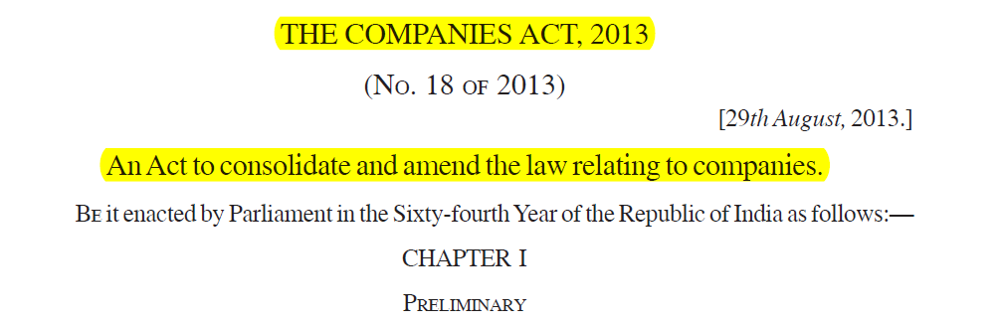
E1. Title Example (Continued)

Slide 39
E2. Preamble
Expresses the scope, object and purpose of the Act more comprehensively than the Long Title.
Recites the ground and cause of making the statute, the evil sought to be remedied or the doubts which may be intended to be settled.
There may be no exact correspondence between preamble and enactment. The enactment may go beyond, or it may fall short of, the indications gathered from the Preamble.
Cannot be resorted to, when the enacting part is clear.
If the Preamble is clear one way and the enacting part is clear the other way, the latter shall prevail.
Preamble of Constitution used for interpreting all laws in India.

Slide 40
E2. Preamble Example (Continued)

Slide 41
E3. Headings
Headings or Titles are prefixed to sections or groups of sections. Chapter headings are also included.
A heading is to be regarded as giving the key to the interpretation of clauses ranged under it, unless the wording of section(s) is inconsistent with such interpretation.
There are conflicting views on utility of headings. In general, “It is well settled that the headings prefixed to sections or entries (of a Tariff Schedule) cannot control the plain words of the provision”.
To determine the sense of a doubtful expression; Indicates the general drift of clause.
Example, a provision contained in Chapter on Winding Up (in Companies Act) cannot be used for Annual General Meeting.
Marginal Notes to be treated as headings.

Slide 42
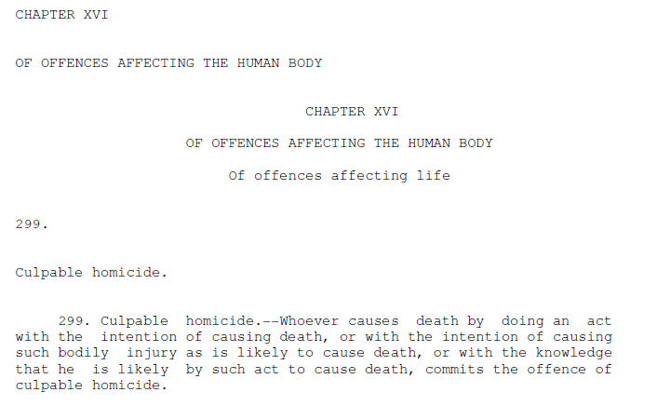
E3. Heading Example (Continued)
Indian Penal Code :-

Slide 43
E4. Punctuation and Brackets
These are minor elements in the construction of statute and very little attention is paid to them.
Have relevance only when the statute is properly punctuated.
If the section as punctuated leads to a conflict the punctuation must be ignored.
Example – Section 27 of the Drugs and Cosmetics Act, 1940 provides that “whoever manufactures for sale, sells, stocks or exhibits for sale or distributes a drug without license, is liable for punishment.”
Does only stocking (as against ‘stocking for sale’) call for punishment? Held that since there is no comma after stocks, it is not an offence to only stock but is an offence to stock for sale.

Slide 44
E5. Illustrations
Illustrations form a part of the statute and though do not form a part of the section, are relevant for interpretation.
Illustrations should not be readily rejected as repugnant to the section.
It shows the intention of framers of the Act and are useful for finding out the intention of the legislature.
Example – Is a diary maintained by a deceased father containing date of births, death and marriages in his family a proof of age of his son under Indian Evidence Act?
Illustration to the relevant section provides that a letter from A’s deceased father announcing the birth of A on a given day is a relevant fact. Held diary is relevant fact since diary similar to letter.

Slide 45

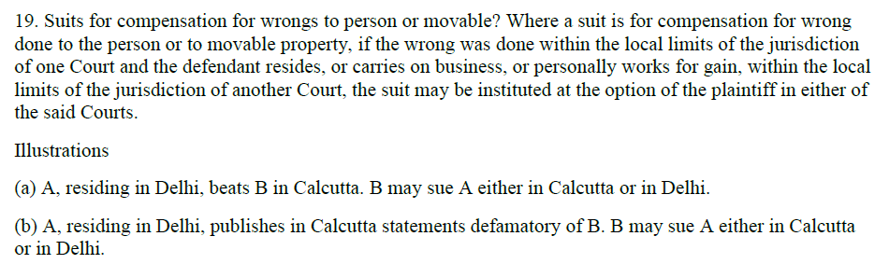
E5. Illustration Example (Continued)

Slide 46
E6. Definitions & interpretation clause
Definitions are used to extend the meaning of a word to include or cover something which is not normally covered or included.
Definitions help in interpreting ambiguous words.
Should not be borrowed from other statutes.
Definitions may be restrictive (means) or extensive (includes).
All statutory definitions must be read subject to the qualifications variously expressed in the provisions were they are used.
In the absence of a definition, the General Clauses Act should be referred. If not defined there also, rules of interpretation shall come into play.

Slide 47
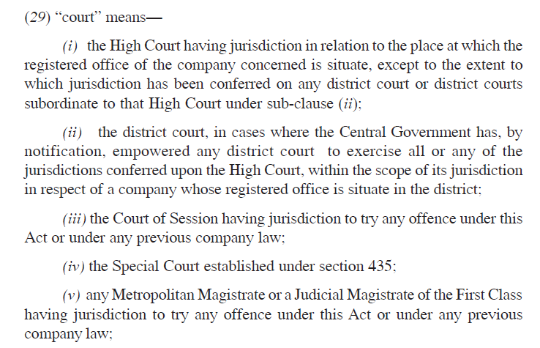
E6. Definitions Example (Continued)
Companies Act – Section 2(29)

Slide 48
E7. Proviso
It is added to the enactment to qualify or create an exception.
It does not state a general rule.
It must be construed with reference to the preceding parts of the clause to which it is appended.
Differs from ‘exception’ and ‘saving clause’ .
It is subordinate to the main section.
It is used to remove special cases from the general enactment and provide for them specifically.

Slide 49
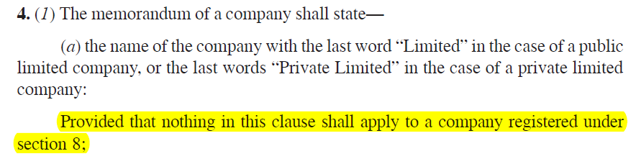

E7. Proviso Example (Continued)

Slide 50
E8. Exceptions and Saving Clauses
Exception restrains the enacting clause to particular cases.
The exception operates to affirm the operation of the statute to all cases not excepted and excludes all other exceptions.
Saving Clause are generally added when a statute is repealed and re-enacted.
Saving Clause is inserted to safeguard rights which would be lost by the general provision.
A saving clause repugnant to the body of the Act is void.
It does not give a further right to the party.

Slide 51
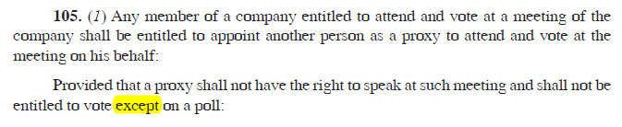
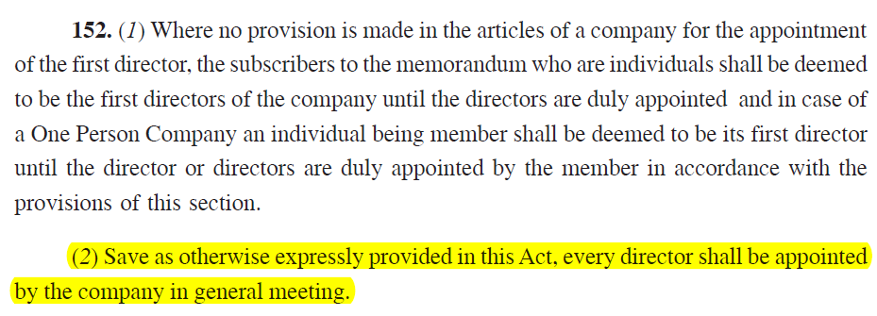
E8. Exceptions & Saving Example (Continued)
Exception :-
Saving Clause :-
Both examples from Companies Act, 2013

Slide 52
E9. Rules
Rules should be treated as external aids. But modern statutes require rules to be read as a part of the act.
Recent example – The Companies Act, 2013
Provide the means by which the general principles in the section may be applied.
Expression used in rules should be construed in consonance with the act.

Slide 53
E10. Explanation
It makes the meaning clear beyond dispute.
It helps in interpreting the true intent of the enactment.
It is not a substantive provision by itself.
If a explanation is given at the end of the section, will it apply to all the provisions of the section?
Held- it should be seen as to which clause it applies.
Explanation may be a negative one too.

Slide 54
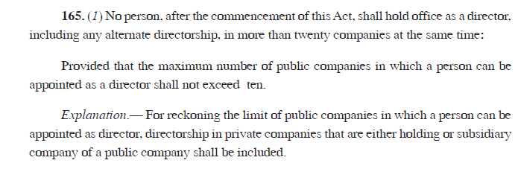
E10. Explanation Example (Continued)
The Companies Act, 2013

Slide 55
E11. Schedule
Schedules form a part of the enactment.
Division of a statute into sections and schedules is only for convenience. Schedule may contain substantive part of the Act.
Often contains minute detail for working out the provisions of the enactment.
Cannot prevail against the express enactment.
If inconsistent with the enactment, the enactment shall prevail.

Slide 56
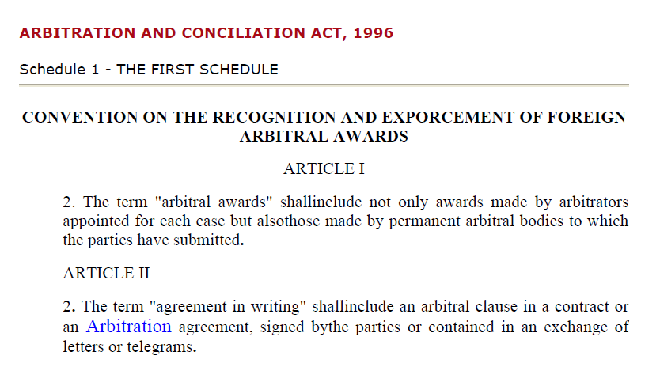
E11. Schedule Example (Continued)

Slide 57
F. External Aids
F1. Dictionaries
F2. Translations
F3. Travaux Preparatoires
F4. Earlier and Later Acts
F5. English Law
F6. Stare Decisis

Slide 58
F1. Dictionaries
Permissible to look in the absence of definition in the relevant statute.
It gives all the meanings of the words.
Selection of a particular meaning, relevant to the context is to be made.
Not to be taken as authoritative exponents.
Definition of a term in one statute, not a guide for construction of the same term in another statute.

Slide 59
F1. Dictionaries Example (Continued)
Punjab General Sales Tax Act, 1948 allows exclusion of turnover of a product on which purchase tax has been paid from the turnover liable for payment of sales tax of the same product.
Question arose - Will the turnover of paddy purchased to produce rice be excluded from the taxable turnover of rice? In other words, are rice and paddy same product?
Held – paddy and rice are identical in terms of dictionary meaning but commercially paddy and rice are two different products. Thus deduction not available.
In this case, the court ruled against using the dictionary meaning.

Slide 60
F2. Translations
Constitution recognizes various languages.
Official translations may be used as guide to interpretation.
Contrasting views have been laid down as to validity of translated versions as an aid to interpretation.
A translator might put his own interpretation while translating. Hence, translated version is a doubtful tool for interpretation.

Slide 61
F3. Travaux Preparatories
It means official records of negotiation and includes statement of objects and reasons, reports of selection committees, speeches and surrounding circumstances etc.
These may be referred to determine the intention of the legislature in an extremely limited way.
Parliamentary debates generally not considered relevant aid as it is ultimately the statute which prevails.
Speeches made in the course of the debate on a Bill cannot reflect the mental process lying behind the majority votes which carried the Bill. Therefore cannot give a meaningful interpretation.

Slide 62
F3. Earlier and Later Acts
When can Earlier / Later Acts be referred?
the subject matter of the statute is same
if the later act is a mere consolidation of the previous acts.
legislature provides for reference to the earlier/later act
If a general act follows a special act, the special act cannot be said to have been repealed. (Company Secretaries Act, 1980 vs. Companies Act, 2013)
If two notifications are issued under two Central Acts, the one issued subsequently shall prevail over the earlier one in case of any inconsistency.

Slide 63
F5. English Law
Referred because they have the same system of jurisprudence as ours.
Assistance in elucidating general principles and construing acts in pari materia.
Indian statutes should be interpreted with reference to the facts of Indian life.
Example – The Company law originated in Great Britain and the Companies Act of India is modelled on British law and experience.
When the provisions of the Indian law and the English Acts are alike the decision of the English Courts throw good light and the reasons may be persuasive.

Slide 64
F6. Stare Decisis
MEANS - “to stand by decisions and not to disturb what is settled”.
A principle of law which has become settled by a series of decisions is generally binding on the courts and should be followed in similar cases.
This doctrine is the basis of common law.
The older the decision, the greater is its authority and the more truly it is accepted as stating correct law.
A precedent by long recognition may mature into Stare Decisis.
This maxim has less relevance in constitutional cases.

Slide 65
Thanks!
Wish you the best !
Anil Chawla Law Associates LLP
www.indialegalhelp.com
info@indialegalhelp.com
Anil Chawla Law Associates LLP is registered with limited liability and bears LLPIN AAA‑8450.
This Presentation is an academic exercise. It does not offer any advice or suggestion to any individual or firm or company. While all efforts have been made to ensure accuracy and correctness of information provided, no warranties / assurances are provided or implied. Readers are advised to consult a Legal Professional / Company Secretary / Chartered Accountant before taking any business decisions. Anil Chawla Law Associates LLP does not accept any liability, either direct or indirect, with regard to any damages / consequences / results arising due to use of the information contained in this Presentation.

