Slide 1
Companies Act 2013 - Key Points relating to Corporate Social Responsibility
Second Edition – May 2017
First Edition – May 2014
Anil Chawla Law Associates LLP www.indialegalhelp.com
Anil Chawla Law Associates LLP is registered with limited liability and bears LLPIN AAA‑8450.
This Presentation is an academic exercise. It does not offer any advice or suggestion to any individual or firm or company. While all efforts have been made to ensure accuracy and correctness of information provided, no warranties / assurances are provided or implied. Readers are advised to consult a Legal Professional / Company Secretary / Chartered Accountant before taking any business decisions. Anil Chawla Law Associates LLP does not accept any liability, either direct or indirect, with regard to any damages / consequences / results arising due to use of the information contained in this Presentation.
Copyright – Anil Chawla Law Associates LLP, 2017
This Presentation relates primarily to CSR provisions as applicable to Indian companies. Statutory requirements related to foreign companies are not covered.

Slide 2
Contents
Deciding if CSR is Applicable
How much to spend?
Constitution of CSR Committee
Permitted Activities
How to spend?
Reporting Requirements
Penalties

Slide 3
A. Deciding If CSR is Applicable
A1. Companies Responsible for CSR
A2. Calculation of Net Worth
A3. Calculation of Turnover
A4. Calculation of Net Profit

Slide 4
A1. Companies Responsible for CSR
Every company (whether private or public) with:
Net Worth of Rs. 500 Crores (Rs. Five Billion) or more OR
Turnover of Rs. 1000 Crores (Rs. Ten Billion) or more OR
Net Profit of Rs. 5 Crores (Rs. Fifty Million) or more

Slide 5
A1. Companies Responsible for CSR (Continued)

Slide 6
A2. Calculation of Net Worth
Add paid up Share Capital
Add Reserves created out of Profit and Securities Premium Account
Subtract Accumulated Losses
Subtract Deferred Expenditure
Subtract Miscellaneous Expenditure not written off
Reserves created out of Revaluation of Assets, write-back of depreciation and amalgamation should not be included
All figures to be as per the Audited Balance Sheet
Example: A company was incorporated fifty years ago with a paid-up capital of Rs. Two Lakhs. The company bought 50 acres of urban land at Rs. 3000- per acre. The company did nothing else in the past fifty years. The land is valued now at about Rs. 20 Crores per acre. The company has done revaluation of the land in its balance sheet. For CSR purposes, the net worth of the company is about Rs. 1.5 Lakhs and not Rs. 1000 Crores.

Slide 7
A2. Calculation of Net Worth (Continued)
Section 2(57)

Slide 8
A3. Calculation of Turnover
Include realization from sale, supply or distribution of goods
Include realization on account of services rendered
Other income may not need to be included (Example - a manufacturing company has an interest income of Rs. 10 Crores and rent income of Rs. 5 Crores. For the purpose of calculating Turnover, rent income will be included while interest income will be excluded).
To be calculated for a financial year

Slide 9
A3. Calculation of Turnover (Continued)
Section 2(91)

Slide 10
A4. Calculation of Net Profit
Include subsidies received from Government – 198(2)
Do not Include Profits of capital nature – 198(3)
Deduct all normal business expenses – 198(4)
Do not deduct income tax, voluntary damages or compensation, loss of capital nature, change in carrying amount of asset or liability – 198(5)
This calculation is independent of Income Tax Act or any other provision of Companies Act.

Slide 11
A4. Calculation of Net Profit (Continued)
Section 198(1)

Slide 12
A4. Calculation of Net Profit (Continued)
Add to Profit all that is received from Government, unless directed otherwise
Section 198(2)

Slide 13
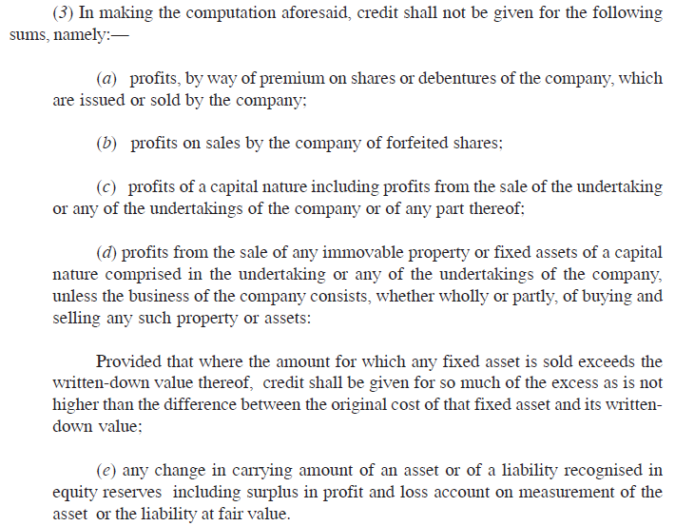
A4. Calculation of Net Profit (Continued)
Section 198(3)

Slide 14
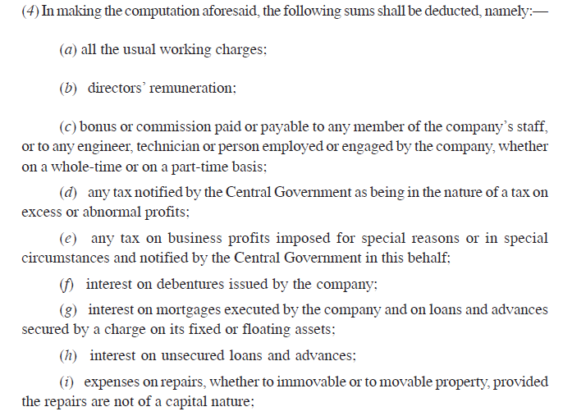
A4. Calculation of Net Profit (Continued)
Section 198(4)(a-i)

Slide 15
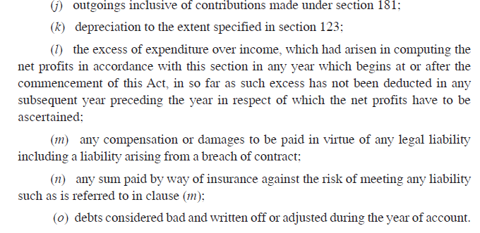
A4. Calculation of Net Profit (Continued)
Section 198(4)(j-o)

Slide 16
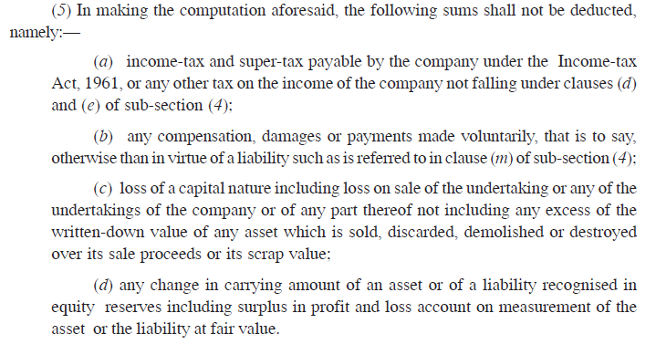
A4. Calculation of Net Profit (Continued)
Section 198(5)

Slide 17
B. How much to spend?
B1. Amount to be Spent

Slide 18
B1. Amount to be Spent
2% (Two per cent) of Average Net Profit of the previous three financial years
Net Profit to be calculated as per sec. 198 (discussed earlier)
If during the past two years before the current year, the company has made losses, the company may still have to spend on CSR if the average net profit is positive.
So, advisable to set aside the CSR provision based on past profits as well as current year profits
Example A – A company with net worth and turnover less than the prescribed limits has made profits of MORE than Rs. Five Crores in the current year. However, its average net profit for the past three years are negative due to past losses. The company will have to constitute a CSR committee and form a CSR Policy even though it will not be required to spend any money.
Example B - A company with net worth and turnover less than the prescribed limits has made profits of LESS than Rs. Five Crores in the current year. The company’s average net profit for past three years is more than Rs. Five Crores. The company need not do anything as regards CSR in the current year.

Slide 19
B1. Amount to be Spent (Continued)
Section 135 (5)

Slide 20
C. Constitution of CSR Committee

Slide 21
C1. Constitution of CSR Committee
Three or more directors out of which at least one to be an independent director
A company without independent director can have a committee without an independent director
If a private company has only two directors, the committee can have only two directors

Slide 22
C1. Constitution of CSR Committee (Continued)
Section 135 (1) and Rule 5(2)

Slide 23
C1. Constitution of CSR Committee (Continued)
Rule 5(1)(i) and (ii)

Slide 24
D. Permitted Activities

Slide 25
D1. Permitted Activities
Eradicating hunger, poverty and malnutrition
Promoting healthcare and sanitation; Safe drinking water
Promoting education
Various facilities and activities for women and elderly
Conservation of natural resources incl. soil, air, water, animals etc.
National heritage, art and culture
Armed forces veterans, war widows and dependants
Sports
Contribution to Prime Minister Relief Fund or any other Govt. fund
Contribution to technology incubators located in approved institutions
Rural development projects
Slum area development

Slide 26
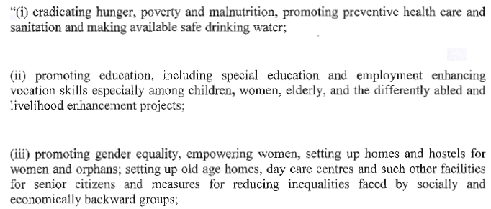
D1. Permitted Activities (Continued)
Schedule VII (i-iii)

Slide 27
D1. Permitted Activities (Continued)
Schedule VII (iv-vii)

Slide 28
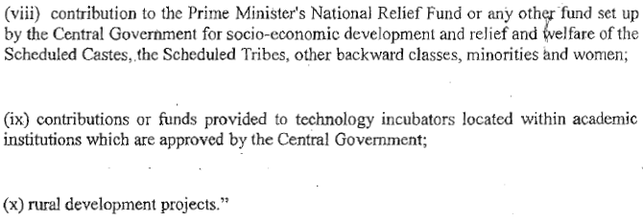
D1. Permitted Activities (Continued)
Schedule VII (viii-xi)

Slide 29
E. How to spend?
E1. Restriction on Activities
E2. Mode of Carrying CSR Activities

Slide 30
E1. Restriction on Activities
Should be as per the Company’s CSR Policy – Rule 4(1)
Activities should not be normal course of business – Rule 4(1)
Activities must be within India – Rule4(4)
Activities benefitting only employees or families not allowed – Rule 4(5)
Building CSR capabilities of employees allowed subject to 5% of CSR expenditure – Rule 4(6)
Contribution to political party not allowed – Rule 4(7)

Slide 31
E1. Restriction on Activities (Continued)
Rule 4(1)

Slide 32
E1. Restriction on Activities (Continued)
Rule 4(5,6&7)

Slide 33
E2. Mode of Carrying CSR Activities
Can be done through a trust / society / section 8 company set up by the company either singly or along with any other company – Rule 4(2)(a)
Can be done through a trust / society / section 8 company set up by the Central or state government– Rule 4(2)(b)
If done through an independent entity, the entity should have three years track record – Rule 4(2) proviso
Mandate to concerned entity should specify modalities of utilizing funds as well as monitoring and reporting mechanism – Rule 4(2) proviso
May also collaborate with other companies – Rule 4(3)

Slide 34
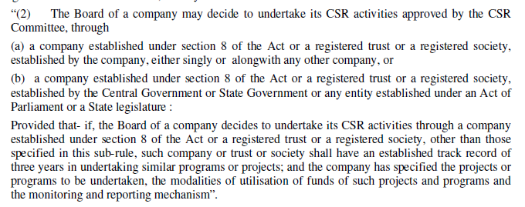
E2. Mode of Carrying CSR Activities (Continued)
Rule 4(2)

Slide 35
E2. Mode of Carrying CSR Activities (Continued)
Rule 4(3&4)

Slide 36
F. Reporting Requirements

Slide 37
F1. Reporting Requirements
Directors’ Report to include contents of CSR Policy – Sec. 135(4)(a)
Directors’ Report to General Meeting to include a report about CSR initiatives as per format in Rules – Sec. 134(3)(o) and Rule 8
Company website to disclose company’s CSR Policy – Sec. 135(4)(a) and Rule 9
If there is a failure to spend CSR amount, Board shall in its report specify the reasons – Sec. 135(5) Proviso

Slide 38
F1. Reporting Requirements (Continued)
Section 134(3)(o) and 135 (4)(a)

Slide 39
F1. Reporting Requirements (Continued)
Rule 8(1) and 9

Slide 40
F1. Reporting Requirements (Continued)
Section 135(5) proviso

Slide 41
G. Penalties
G1. Failure in Reporting
G2. Failure in Spending

Slide 42
G1. Failure in Reporting
Refers to non-compliance under section 134(3)(o) relating to Directors’ Report
More serious offence than not spending CSR money
Minimum fine on company Rs. 50,000- Maximum fine Rs. 25,00,000- (Rs. Two and a half million)
Officer in default liable for imprisonment up to three (3) years and / or Fine of Rs. 50,000- to Rs. 500,000-

Slide 43
G1. Failure in Reporting (Continued)
Section 134(8)

Slide 44
G2. Failure in Spending
Less serious offence – only fine and no imprisonment
No specific punishment provided. Covered under sec. 450 and 451, which are residual provisions
Fine of up to Rs. 10,000 and in case of continuing default Rs. 1000 per day
In case of repeated default within three years double fine. No imprisonment even for repeated offence
Moral – Spending is less important than reporting.

Slide 45
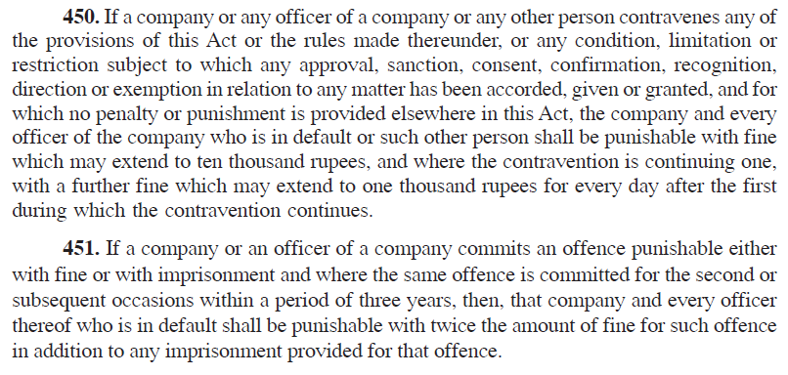
G2. Failure in Spending (Continued)
Section 450 and 451

Slide 46
Helps you with –
Strategic Advice, International Investment Arbitration, International Commercial Arbitration, Corporate Relationships, Resolving Disputes without Litigation, Structures for Global Business Entities, Research based opinion
We take an entrepreneur’s perspective on every issue.
Seeing our clients' business grow and prosper is our passion.
www.indialegalhelp.com
info@indialegalhelp.com
We follow a transparent system for fees. Please look at our Indicative Rates (http://www.indialegalhelp.com/files/indicativerates.pdf ) before contacting us.

