Slide 1
Constitutional Aspects of Indirect Taxes
Session at Certificate Course on Indirect Taxes organized by
The Indirect Taxes Committee,
The Institute of Chartered Accountants of India
Bhopal
19 October 2013
By Advocate Anil Chawla
(B.Tech. LL.B.)
Senior Partner,
Anil Chawla Law Associates LLP
www.indialegalhelp.com

Slide 2
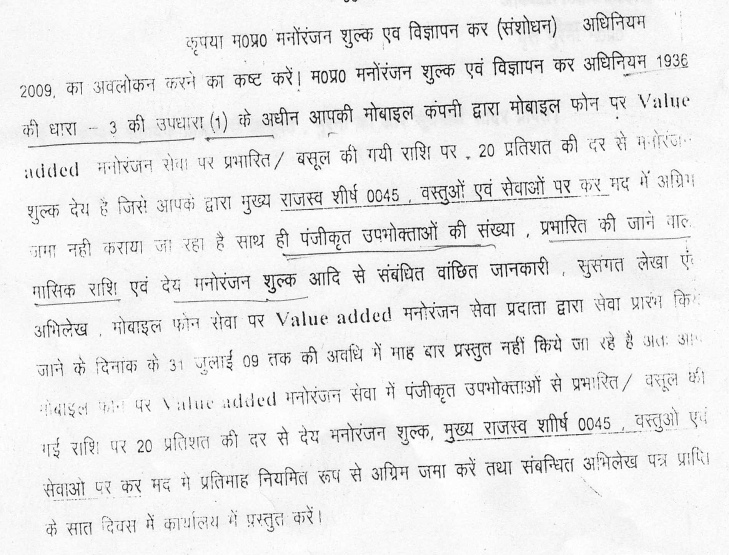
A Problem to Ponder

Slide 3



Right to Impose Taxes
Note: Article 265 applies only to tax and not fees.

Slide 4
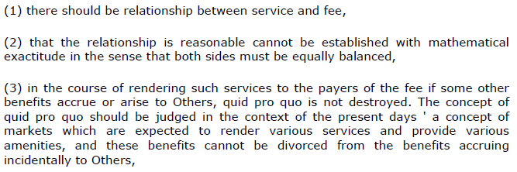
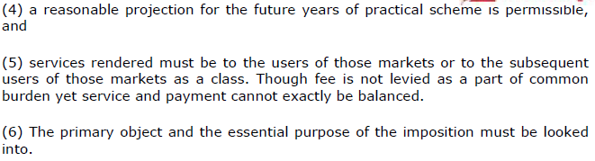
Tax vs. Fees
Southern Pharmaceuticals and Chemicals, Trichur and Ors. (1981) SCC 391 and I.T.C. Ltd. v. State of Karnataka (1985) SCC 476 quoted by SC in Bangalore Development Authority vs. The Air Craft Employees Cooperative Society Ltd. and Ors. MANU/SC/0053/2012

Slide 5
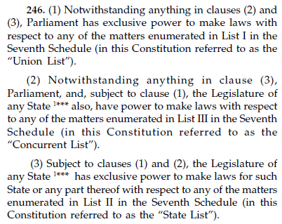
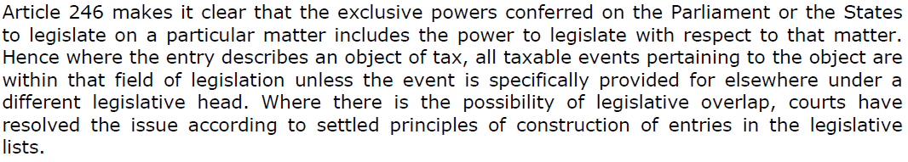
Division of Powers

Slide 6
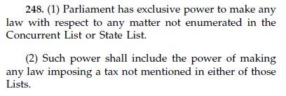
Residuary Powers

Slide 7
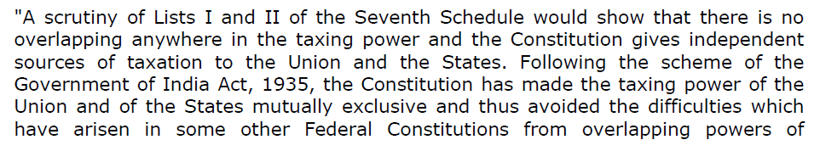
No Overlap between Union and State
No taxation powers are in Concurrent List.

Slide 8
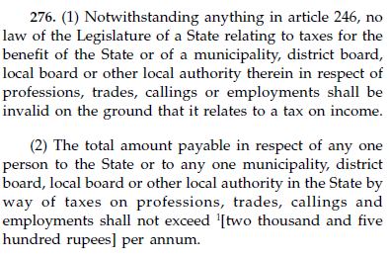
Limit of Professional Tax

Slide 9

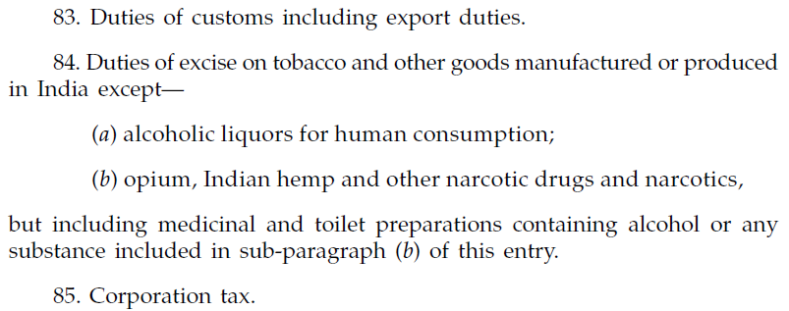
Union List Items of Indirect Taxation

Slide 10
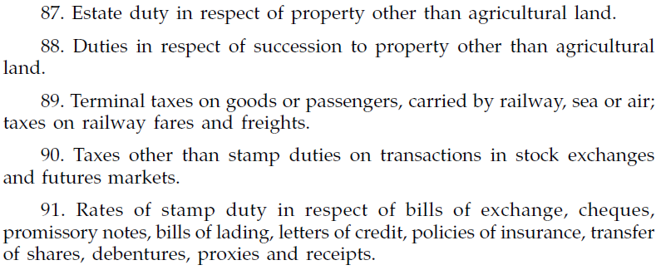
Union List Items of Indirect Taxation (Continued)

Slide 11
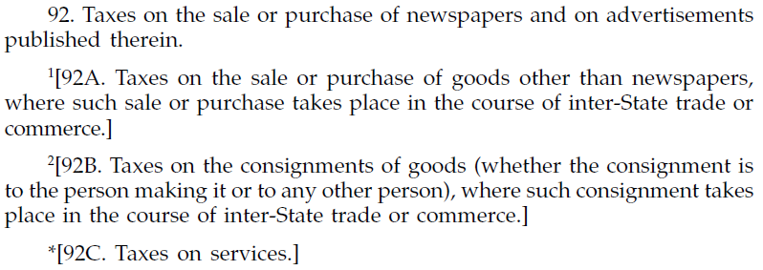
Union List Items of Indirect Taxation (Continued)

Slide 12
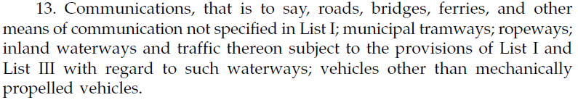
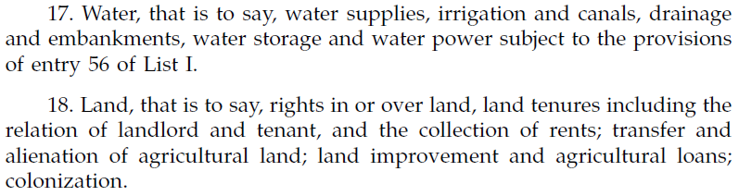

State List Items of Indirect Taxation

Slide 13
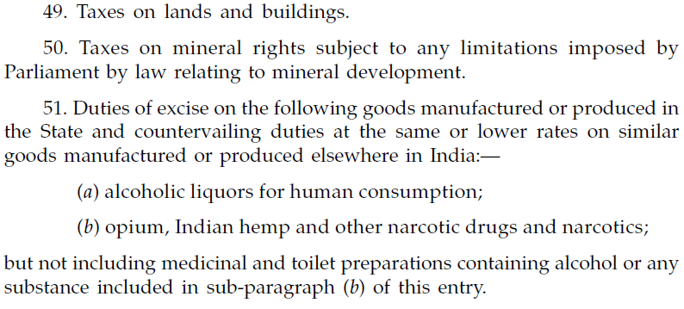
State List Items of Indirect Taxation (Continued)

Slide 14
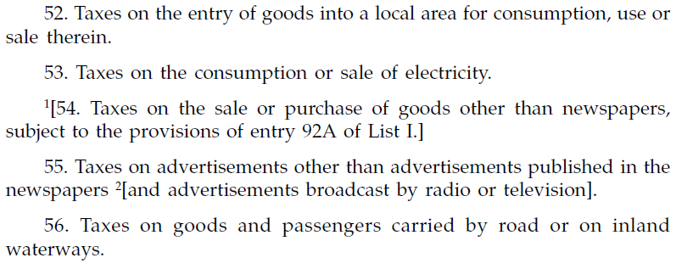
State List Items of Indirect Taxation (Continued)

Slide 15
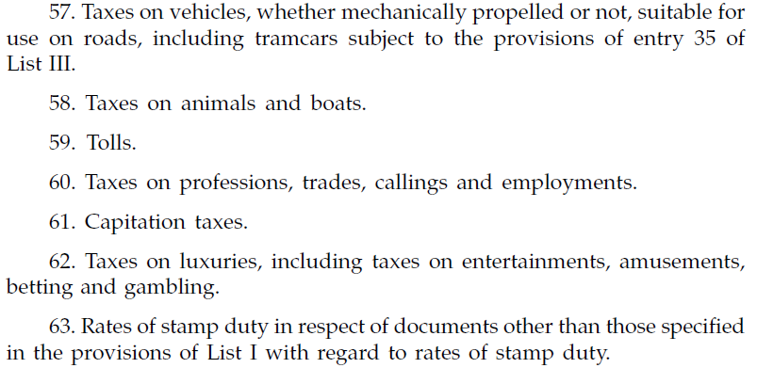
State List Items of Indirect Taxation (Continued)

Slide 16

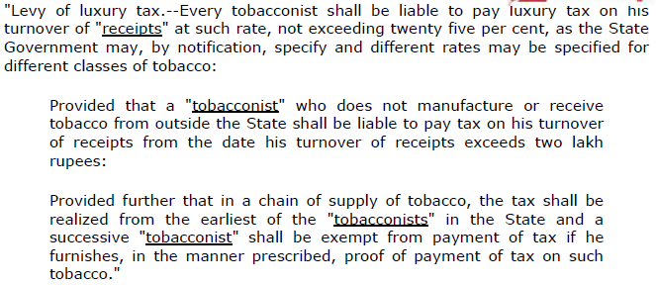
Illustrative Case

Slide 17
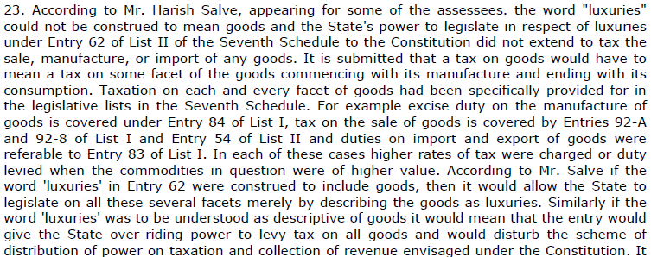
Illustrative Case (Continued)

Slide 18
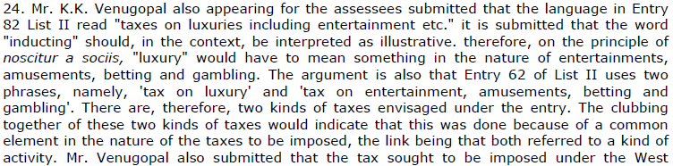
Illustrative Case (Continued)

Slide 19

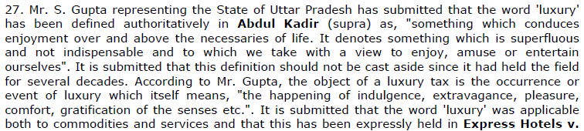
Illustrative Case (Continued)

Slide 20
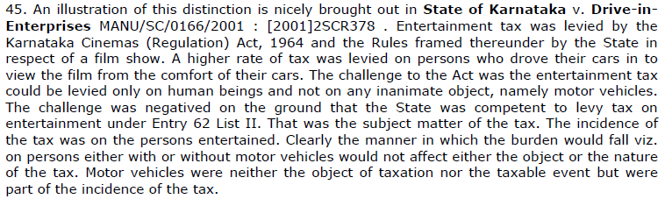
Illustrative Case (Continued)

Slide 21
Illustrative Case (Continued)

Slide 22
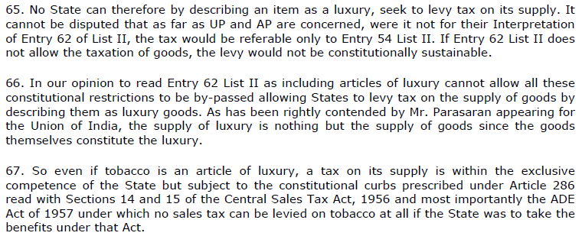
Illustrative Case (Continued)

Slide 23
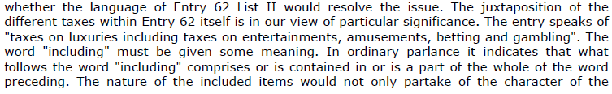
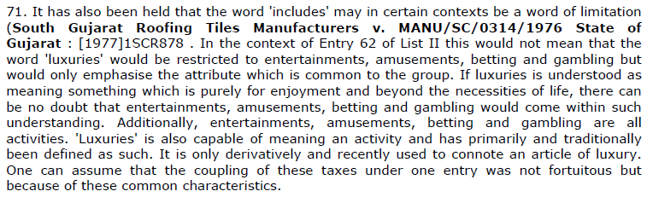
Illustrative Case (Continued)

Slide 24
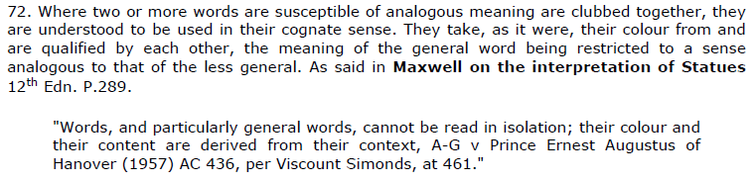
Illustrative Case (Continued)
Noscitur A Sociis

Slide 25
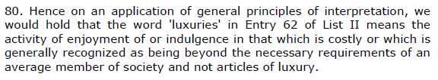
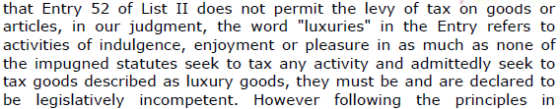
Illustrative Case (Continued)

Slide 26
Entertainment Tax on Value Added Services
Value Added Services provided as part of mobile telephone services are exclusively covered by Entry 31 of List I Union List of Seventh Schedule.
Taxation of services is under exclusive power of the Union of India under Entry No. 97 of List I Union List of Seventh Schedule of the Constitution

Slide 27
Entertainment Tax on Value Added Services
Value Added Services provided as part of mobile telephone services are exclusively covered by Entry 31 of List I Union List of Seventh Schedule.
Taxation of services is under exclusive power of the Union of India under Entry No. 97 of List I Union List of Seventh Schedule of the Constitution
There can be no justification for treating them under Entry 62 of List II State List of Seventh Schedule (Taxes on luxuries, including taxes on entertainments, amusements, betting and gambling). Hence, the Legislature of state of Madhya Pradesh has no power under the Constitution to legislate in the matter of Value Added Services

Slide 28
Entertainment Tax (Continued)
Petitioner is supported in his contention by the judgment of Honourable Supreme Court in the matter of Godfrey Phillips (I) Ltd.& Anr. vs. State of U.P.& Ors. (2005 AIR 1103, 2005 (1 ) SCR 732).
The well-established principle of law is that “pith and substance” or true nature (and not any one attribute or quality) of an activity or goods or service has to be seen before deciding the legal category to which it belongs. For example, the Honourable Supreme Court has opined that a luxury vehicle is to be taxed as a vehicle and not as a luxury. A state legislature cannot levy luxury tax on a luxury vehicle. Similarly, when children go to school, the primary and essential activity is education. It will be beyond the legal competence of a state legislature to levy entertainment / luxury tax on children going to school irrespective of the facts that the children have great fun in school or that the school is a very expensive one where only the super-rich can afford to send their children.

Slide 29
Entertainment Tax (Continued)
In case of value added services on mobile phones, the true nature / pith and substance is communication, while entertainment, if any, is purely incidental and non-essential. Hence, the state legislature has no legal competence to impose any tax on value added services.
The principle of pith and substance has been accepted by courts even when interpreting with reference to The M.P. Entertainments Duty and Advertisements Tax Act, 1936. In the matter of Calico Mill Limited vs. State of M.P. (AIR 1961 MP 275: 1961 MP LJ 474: 1961 JLJ 376) the Honourable High Court faced a question whether a fashion show (where the admission was for Rs. 2 each) organized for promoting sale of clothes of the petitioner was an entertainment. The Honourable High Court held that the primary and essential purpose of the show was sale of goods and any entertainment that happened there was incidental; therefore the fashion show could not be labeled as an entertainment and no entertainment tax was leviable on the same.

Slide 30
Entertainment Tax (Continued)
It has been held that the primary purpose of a museum is enhancement of knowledge and not entertainment; and hence no entertainment tax can be levied on museum entry fees.
If the logic of taxing on the basis of effect on the minds of customers is extended to its extreme limit, a day may come when customers may be charged entertainment tax on their telephone conversations based on the content of the talk that they had on the phone - if a caller tells a joke to his friend on the other end he will be charged entertainment tax on the conversation.
Section 2(b) of M.P. Entertainments Duty and Advertisements Tax Act, 1936 does not mention being entertained or not being entertained as a criterion for levy of tax. Just as a film that is extremely boring cannot be exempted from payment of entertainment tax on ground of absence of entertainment, there can be no justification for levy of entertainment tax on any service or activity on the ground that the service or activity caused entertainment.

Slide 31
Concluding Remarks
Never assume that just because a tax is imposed by Parliament, State Legislature or Municipal body, it is constitutionally valid.
Governments have an ever-increasing appetite. So they keep thinking of innovative ways to remove money from common man’s pocket. In their enthusiasm, they often make mistakes.
Constitution of India has many safeguards to limit the powers of various governments with regard to imposition of taxes.
It is the duty of chartered accountants, tax professionals, advocates and vigilant citizens to keep check on governments.

Slide 32
Thanks!
Hope that you did not get bored
and that it was useful!
Anil Chawla Law Associates LLP
www.indialegalhelp.com
info@indialegalhelp.com
Tel. – 09425009280

